Slide 1
Remediation in COlorado

Slide 2
Colorado GEAR UP SUCCESS

Slide 3
Success Story
Meet one of Colorado GEAR UP’s rising stars
Osvaldo’s Story – Osvaldo Cabrera, an eighth-grader enrolled in a middle school near Denver, talks about how Colorado GEAR UP's early remediation strategy is helping him prepare for college.
https://www.youtube.com/watch?v=-PUo66TPJ3Q

Slide 4
High School Graduation Rates
On-Time graduation rates for students graduating after the 2010-2011 school year.
Colorado GEAR UP
vs.
Statewide

Slide 5
College Matriculation Rates
Entering college in the fall term immediately following graduation for students graduating after the 2010-2011 school year.
Colorado GEAR UP
vs.
Statewide

Slide 6
College Persistence Rates
Entering college in the fall term immediately following graduation and persisting through spring of year 1 for students graduating after the 2010-2011 school year. This is compared to the 2010-11 statewide retention rates, student returning in fall of year 2.
Colorado GEAR UP
vs.
Statewide

Slide 7
Ethnicity Demographics
Comparison of the two largest ethnicity groups for 2011 graduates.
Colorado GEAR UP
vs.
Statewide

Slide 8
Income Demographics
Comparison of income related demographics for 2011 graduates.
Colorado GEAR UP
vs.
Statewide

Slide 9
Challenge: Remedial Rates
Colorado GEAR UP 2011 graduates assessed as needing remediation compared with statewide remedial rate from 2011 report (2010 graduates)
Colorado GEAR UP
vs.
Statewide

Slide 10
Challenge for Remedial Students
Graduation rates for remedial and non-remedial students from the 2011 remedial report (table 9).
Statewide

Slide 11
2016 Goal: 0% Remedial Rate
Using early intervention and remedial coursework during high school, getting course completions on high school transcripts, Colorado GEAR UP seeks to reduce their cohort remedial rate to zero.
Colorado GEAR UP

Slide 12
Early remediation
Colorado GEAR UP

Slide 13
Early Remediation
Pilot group consisted of 8th graders from two middle schools.
2012-13 remedial group currently has 8th and 9th graders from eight schools
Colorado GEAR UP

Slide 14
Subject Mastery Progress (Aug – Dec)
Pre-Algebra course progress through mid-year 2012-13. The graph shows 8th and 9th grade students
Colorado GEAR UP

Slide 15
Mid-Year Progress Report 50%+ Mastery
Pre-Algebra course progress through mid-year 2012-13. The graph shows 8th and 9th grade students
Colorado GEAR UP

Slide 16
Remediation of first-time college students

Slide 17
Remediation Rates
Nationally
Four year institutions = 20%
Two year institutions = 50%
Colorado
Four year institutions = 21%
Two year institutions = 58%
Overall = 31.8%
Nationally: DHE, 2011 Report on Remedial Education; Feb 2012, Report Summary; Education Commission of the States
Colorado: DHE, 2011 Report on Remedial Education; Feb 2012; http://highered.colorado.gov/i3/Reports.aspx?cat=7

Slide 18
For Every 100 Students Entering College…
31 are Assigned to Remediation
Source: DHE, 2011 Report on Remedial Education; Feb 2012; http://highered.colorado.gov/i3/Reports.aspx?cat=7
31.8% of incoming recent high school graduates in CO are assigned to remediation in at least one subject

Slide 19
Remediation Rates
Source: DHE, 2011 Report on Remedial Education; Feb 2012; http://highered.colorado.gov/i3/Reports.aspx?cat=7

Slide 20
Remediation Rates by Discipline
Remediation by Sector, FY 2011 (Fall 2010)
First-Time Recent High School Graduates
Sector | Math only | Writing Only | Reading Only | Math Writing only | Math Reading only | Writing Reading only | All (Math, Writing, Reading)
2-year Institutions | 14% | 5% | 1% | 10% | 2% | 6% | 19%
4-year Institutions | 9% | 2% | 1% | 3% | 1% | 1% | 3%
Statewide Total | 11% | 3% | 1% | 6% | 1% | 3% | 8%
Source: DHE, 2011 Report on Remedial Education; Feb 2012; http://highered.colorado.gov/i3/Reports.aspx?cat=7

Slide 21
Remediation Rates by Discipline
Two-Year Institutions
Four-Year Institutions
Source: DHE, 2011 Report on Remedial Education; Feb 2012; http://highered.colorado.gov/i3/Reports.aspx?cat=7

Slide 22
Remediation Rates by Gender
Source: DHE, 2011 Report on Remedial Education; Feb 2012; http://highered.colorado.gov/i3/Reports.aspx?cat=7
Notes:
As you can see slightly more females require remediation at both the 2 and 4 year schools.

Slide 23
Remediation Rates by Ethnicity
Source: DHE, 2011 Report on Remedial Education; Feb 2012; http://highered.colorado.gov/i3/Reports.aspx?cat=7
Notes:
This chart represents the breakdown of students needing remediation by race/ethnicity categories. For both 4 and 2 year schools the black non-hispanic category has the highest percent of students needing remediation.

Slide 24
Performance of Remedial Students

Slide 25
Performance
Retained in Second Year
Non-Remedial Students = 75.2%
Remedial Students = 57.7% (17.5 percentage points below)
Graduation Rates (6-year rate at Four-Year Institutions)
Non-Remedial Students = 57.7%
Remedial Students = 29.5% (28.2 percentage points below)
Source: DHE, 2011 Report on Remedial Education; Feb 2012; http://highered.colorado.gov/i3/Reports.aspx?cat=7; Table 8

Slide 26
For Every 100 Students Entering College
…17 needed remediation and are still in college the next year
Source: DHE, 2011 Report on Remedial Education; Feb 2012; http://highered.colorado.gov/i3/Reports.aspx?cat=7
31.8 % of incoming recent high school graduates in CO are assigned to remediation, 57.7% of those are retained following fall

Slide 27
Retention Rates (for Remedial Students)
Retained One Year by Sector, Fall 2009 to Fall 2010
First-Time, Recent High School Graduates Assigned to Remediation
Sector | Number of 1st Time Students | All Students Retained Next Year | Not Assigned to Remediation and retained next year | Assigned to Remediation in at least one subject and retained next year
Recent Colorado High School Graduates Two-Year Public | # | % | % | %
Two-Year Public Institutions | 8287 | 54.9% | 55.9% | 54.3%
Four-Year Public Institutions | 20,704 | 75.7% | 78.5% | 62.7%
Grand Total | 28,911 | 69.8% | 75.2% | 57.7%
Source: DHE, 2011 Report on Remedial Education; Feb 2012; http://highered.colorado.gov/i3/Reports.aspx?cat=7 Table 8
Notes:
One common measure of success for students is retention – meaning if a student starts in the fall are they enrolled the next fall. Here we have broken out one year retention by those students needing remediation and not needing remediation. So the one year retention rate for students not assigned to remediation at the 2 year level is 55% versus 50% for those students needing remediation. At the 4 year level 77% were retained that didn’t have remedial needs versus 54% of students who required remediation.
Overall 74% of students with no remedial needs were retained one year compared to 55% for students needing remediation.

Slide 28
For Every 100 Students Entering College
…9 needed remediation and earned a Bachelor’s degree in 6-years
Source: DHE, 2011 Report on Remedial Education; Feb 2012; http://highered.colorado.gov/i3/Reports.aspx?cat=7
31.8% of incoming recent high school graduates in CO are assigned to remediation, 29.7% of those graduate with bachelor degree in 6 yrs

Slide 29
Graduation Rates at 2-Years (Remedial Students)
Graduation Rates by Remedial and Non-Remedial Students (2007 Cohort)
First-Time, Recent High School Graduates Assigned to Remediation
Sector | Fall Term Entering Class | Graduated at Original Institution | Graduated at Transfer Institution | Graduated at Either
First Time Students Entering a Two Year Public Institution | 5,845 | 20.3% | 0.6% | 20.9%
First Time Students Entering a Two Year Public Institution Requiring Remediation | 3,780 | 15.8% | 0.4% | 16.2%
SOURCE: SURDS Enrollment, Fall 2007; Degrees Awarded FY 2007-2010 and Summer 10 Source: DHE, 2011 Report on Remedial Education; Feb 2011; http://highered.colorado.gov/i3/Reports.aspx?cat=7
Notes:
Another measure of success is graduation rates – did a student graduate. At the 2 year schools students with remedial needs 19% graduated versus 23% for those with no remedial needs – another measure is looking to see if they not only graduated but transferred as this is another measure of success for the community colleges…in this case 19% of students with remedial needs graduated compared to 26% of students with no remedial needs.

Slide 30
Graduation Rates at 4-Years (Remedial Students)
Graduation Rates by Remedial and Non-Remedial Students (Fall 2004 Cohort)
First-Time, Recent High School Graduates Assigned to Remediation
Sector | Fall Term Entering Class | Grad. within 4 Years | Grad. within 5 Years | Grad. within 6 Years
First Time Students Entering a Four Year Public Institution | 19,030 | 29.7% | 51.0% | 57.2%
First Time Students Entering a Four Year Public Institution Requiring Remediation | 3,252 | 9.3% | 23.1% | 29.7%
SOURCE: SURDS Enrollment, Fall 2004; Degrees Awarded FY 2005-2010 and Summer 10 Source: DHE, 2011 Report on Remedial Education; Feb 2012; http://highered.colorado.gov/i3/Reports.aspx?cat=7
Notes:
For the 4 year colleges we look at graduation in 4 year, 5 years, or 6 years, using the 6 year measure of graduation – 58% of students with no remedial needs graduated compared to 30% of students with remedial needs.
For both 2 and 4 year schools students who enter with remedial needs are less likely to be retained and ultimately graduate.

Slide 31
Cost of Remediation

Slide 32
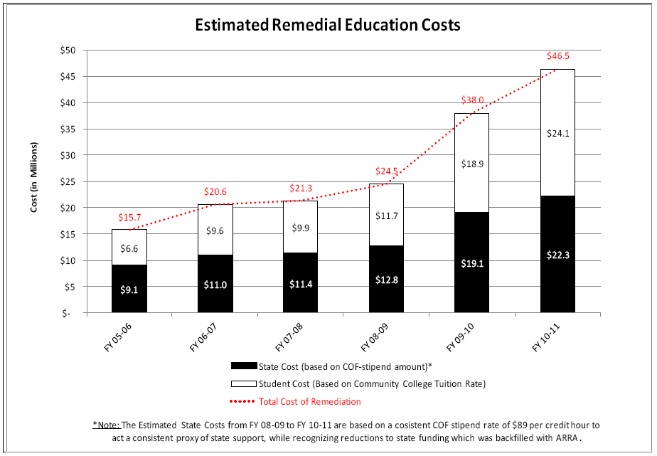
Colorado
Source: DHE, 2011 Report on Remedial Education; Feb 2012; http://highered.colorado.gov/i3/Reports.aspx?cat=7

Slide 33
Cost of Remediation
Colorado - $46.5 million ($22.3m state funds)
Arkansas - $65.7 million ($24m state funds)
Increased 99% from 1998 to 2008
Florida - $224 million ($123m state funds)
Michigan - $22 million state funds
Nebraska – $77.8 million ($2,497 per FTE)
Education Commission of the States; Report: Getting Past Go, http://www.gettingpastgo.org/docs/CostofRemedialEducation-StateReports.pdf
Arkansas, 2007-08: http://www.adhe.edu/SiteCollectionDocuments/Institutional%20Finance%20Division/Publications/UR2007-08.pdf
Colorado, 2008-09: DHE, 2011 Report on Remedial Education; Feb 2012; http://highered.colorado.gov/i3/Reports.aspx?cat=7
Florida, 2007-08: http://blogs.orlandosentinel.com/news_education_edblog/2011/05/florida-spends-millions-to-remediate-college-students.html
Michigan, 2009: http://www.gettingpastgo.org/docs/CostofRemedialEducation-StateReports.pdf
Nebraska, 2008-09: http://www.ccpe.state.ne.us/PublicDoc/CCPE/CCStudy/LB%20340%20Community%20College%20Study.pdf

