Slide 1
Making Data Work for You:
A Colorado Story
Dr. Beth Bean
Director of Research and Information
Colorado Department of Higher Education
Ryan Allred
Senior Data Systems Engineer
Colorado Department of Higher Education &
Colorado GEAR UP
NCCEP Capacity Building Workshop
February 5, 2013

Slide 2
Agenda
About Colorado
  Data Tracking and Best Practices
Opportunities
Challenges

Slide 3
Agenda
About Colorado
  Overview, Data Tracking
Data Used in Decisions
  GEAR UP, State, National
Best Practices
  GEAR UP, State

Slide 4
Highlights
Colorado

Slide 5
High School Graduation Rates
On-Time graduation rates for students graduating after the 2010-2011 school year.
Colorado GEAR UP
vs.
Statewide

Slide 6
College Matriculation Rates
Entering college in the fall term immediately following graduation for students graduating after the 2010-2011 school year.
Colorado GEAR UP
vs.
Statewide

Slide 7
College Persistence
Rates
Entering college in the fall term immediately following graduation and persisting through spring of year 1 for students graduating after the 2010-2011 school year. This is compared to the 2010-11 statewide retention rates, student returning in fall of year 2.
Colorado GEAR UP
vs.
Statewide

Slide 8
Ethnicity
Demographics
Comparison of the two largest ethnicity groups for 2011 graduates.
Colorado GEAR UP
vs.
Statewide

Slide 9
Income Demographics
Comparison of income related demographics for 2011 graduates.
Colorado GEAR UP
vs.
Statewide

Slide 10
DUAL/CONCURRENT
Enrollment
Colorado has several concurrent enrollment programs including the state sponsored CONCURRENT and ASCENT programs. In addition, there are many institutional sponsored programs.
Statewide

Slide 11
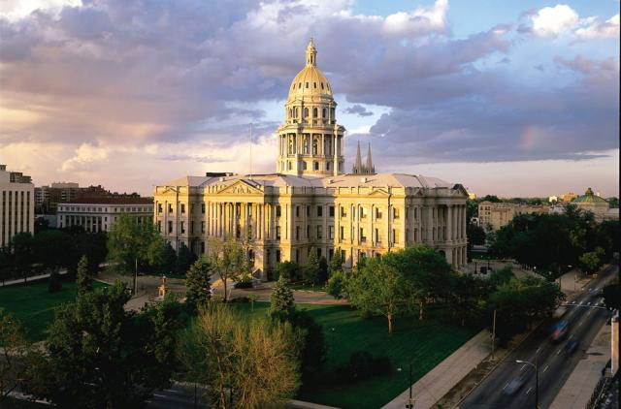
State Capitol
Image from: colorado.com

Slide 12

Beth Bean last Saturday

Slide 13
Higher education Overview
The State of Colorado

Slide 14
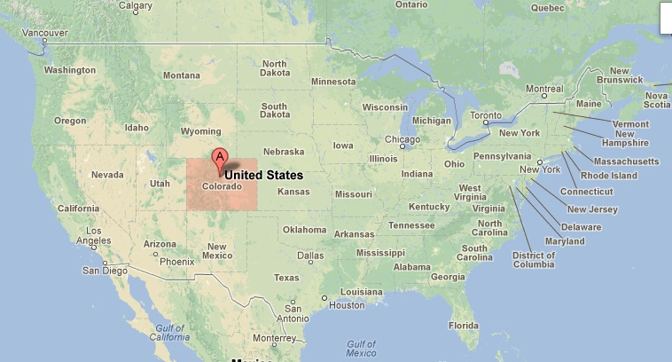
We Are Here

Slide 15
About Colorado
5.1 million - Population (July 2011, Dept of Local Affairs)
4.2 Million in Front Range (Pueblo to Ft. Collins)
2 million Households (Census 2010)
854,265 – K-12 students
432,500 – Postsecondary students
Website: Colorado.gov

Slide 16
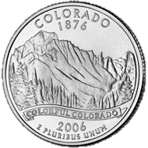

About Colorado

Slide 17
Colorado Demographics
Source: 2010 Census - http://dola.colorado.gov/dlg/demog/2010censusdata.html

Slide 18
Colorado Job Demographics
Source: 2010 Census - https://dola.colorado.gov/demog_webapps/jsn_parameters.jsf

Slide 19
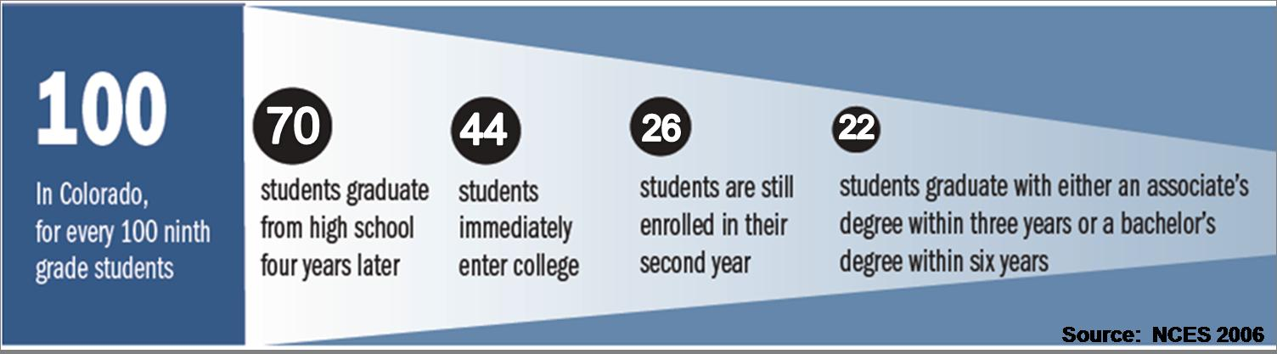
The Colorado Paradox & Promise
  Close the Achievement Gaps
  Halve the Drop Out Rate
  Double the number of Certificates & Degrees
  Increase Student and Family awareness of Career Pathways.
Colorado Department of Higher Education NCCEP Capacity Building Workshop - February 5, 2013
Notes:
Do you strongly agree or disagree with the belief?

Slide 20
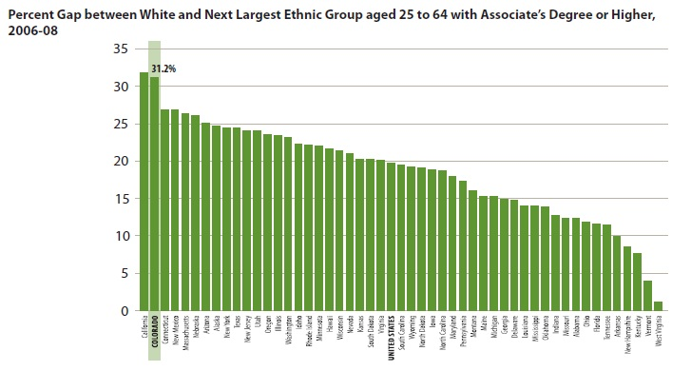
Minding the Colorado Gap – Ethnicity/Race
Notes:
When we divide this data further and look at educational attainment by race and ethnicity – you see the traditional “gap” that people typically think of – Colorado has one of the largest gaps – only surpassed by CA. this gap looking at the percent of whites who have a degree compared to the percent of minorities in the highest ethnic category that have a degree. In this case for CO it would be Hispanic students. Currently just over 15% of Hispanic students have a certificate or degree beyond HS. 8% have a bachelors degree. If things remain the same only 9% of Hispanic males in high school today will go onto higher education.

Slide 21
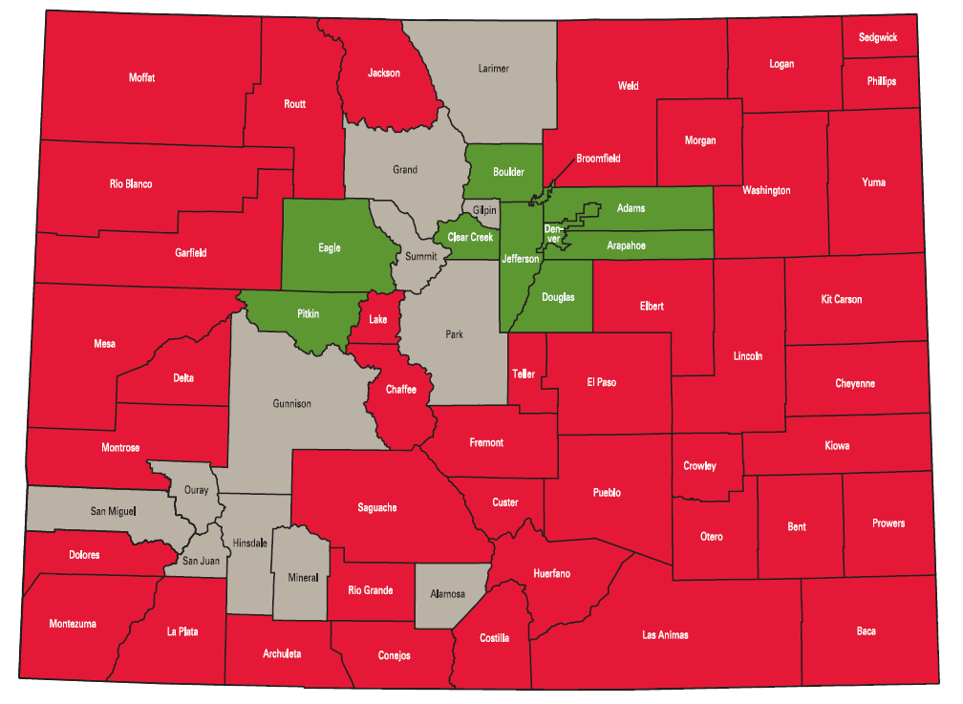
The Colorado Gap - Income
Notes:
This slide represents other ways we can speak of the gap. There are numerous groups that fall into the gap other than just minority groups. Other areas where CO is falling behind in serving include low income students and adult student. Research supports that there is a correlation between level of income and level of educational attainment. Lower income students have lower educational attainment and students from higher levels of income have higher levels of educational attainment. The red in this map represents low educational attainment and low family income and the gray areas represents neutral zones that are fairly average. The green represents those areas of in CO that have high personal wealth and high educational attainment – in co these are focused around the Denver area.

Slide 22
Percentage of Jobs in 2018 that
Will Require a Postsecondary Education, by State

Slide 23


Big Data: The shifting paradigm…….
B.C. – Be Closed
A.D. – Access to Data
DATA
Notes:
Before I jump into specific data issues in Colorado I want to briefly discuss a cultural paradigm that is occurring. In the past which I will call BC for “be closed” data was treated as a item to be coveted and kept secret. People were very possessive of their data and liked having it and hoarding it and not sharing – not unlike gholum in lord of the rings. Luckily we are moving into the present and future which I will call AD for access to data. There is a national and international movement to open data and data sharing. One example of this is Data.gov – is anyone familiar with data.gov? It has almost 400K raw data sets available from federal, state, and local governments. It is like the old open source Napster but for data nerds. In Colorado the idea of a Colorado Marketplace is being explored, which is a small initiative tied to SLDS but would be a local open data source.
These are all examples of the open data movement and the shift to making data available and to create more data linkage and sharing.

Slide 24

Statewide Longitudinal Data Systems
National Center for Education Statistics (NCES), specifically Institute of Education Sciences (IES).
Grants – four rounds of ARRA funding
41 states to date
Aid state education agencies to develop and implement longitudinal data systems

Slide 25

Postsecondary Student
Concurrent Enrolled in HS
23 year old Hispanic Male
1110 on SAT
B.A. English
153 hours to graduate
3.04GPA
2 semesters of remediation in Math
Transferred from Community College
Average per Year $4,623 Financial Aid

Slide 26
K-12 and Postsecondary Link
ESL
600 Science CSAP Score
11th Grade ACT
3.44 GPA
College Student
FRL 5 years
Cherry Creek H.S.
Cherry Creek Middle School
K-12 Student

Slide 27
Education to Workforce
College Student
Area of Employment
Salary Data
K-12 Student
Employee
Employment Duration

Slide 28
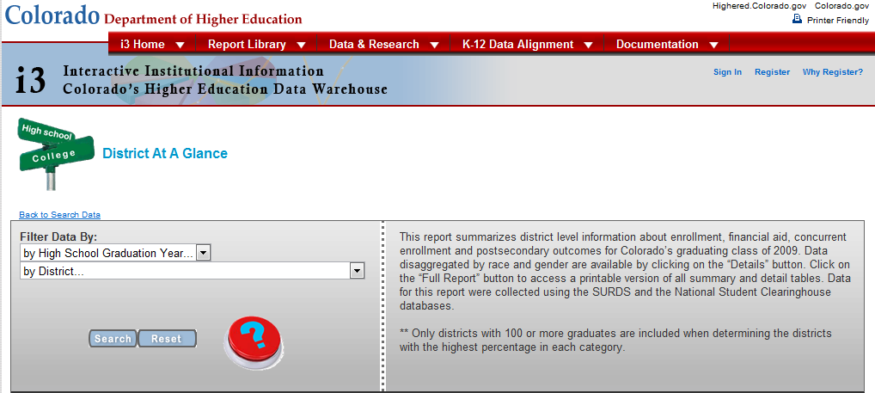
District at a Glance Search Tool

Slide 29
Data Links
(Legislative Action)
2002 – required longitudinal analysis of the CSAP test, creating the SASID (CRS 22-7-603.5)
2008 - every postsecondary institution in Colorado must provide each enrolled student with a unique identifier (CRS 23‐5‐127.4)
2008 – unified data protocols, open data sharing between state agencies (HB 08-1364)

Slide 30
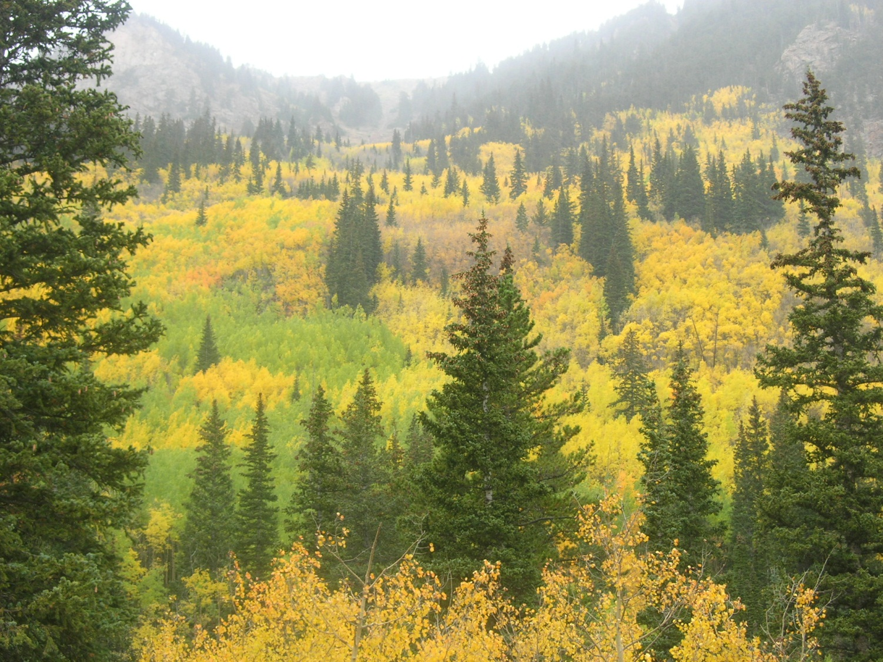
Kenosha Pass, Jefferson County

Slide 31
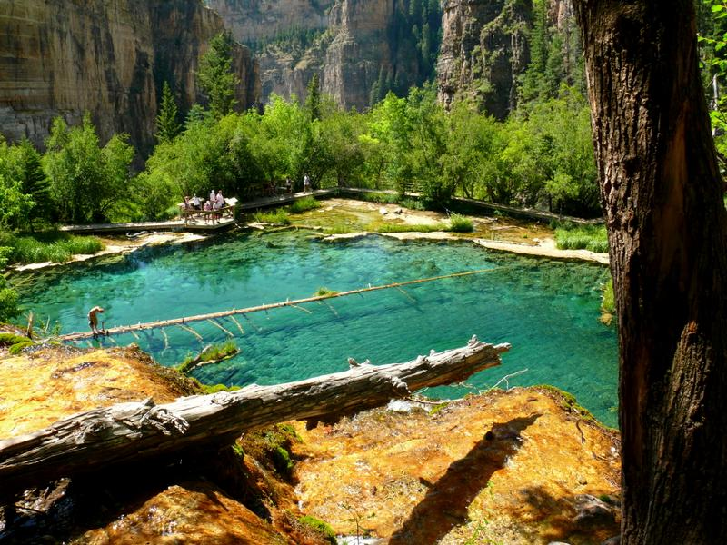
Hanging Lake, Glenwood Canyon, CO; 7,040 feet above sea level

Slide 32

Data tracking
Data Flow from GEAR UP to the Governor

Slide 33
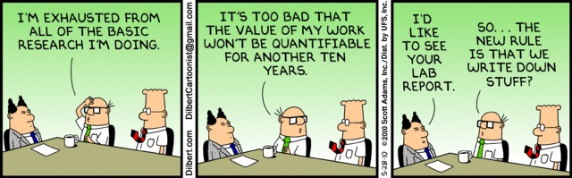
Data?

Slide 34
Data versus Information
DATA
INFORMATION
Raw input
Qualitative or quantitative attributes
Not significant alone
Observations and recordings done to obtain data
Derived from Data
Information is a concept
Significant alone
Analysis done to obtain information

Slide 35
Downstream Data Flow – State View
Unit Record Student Data, Point on Entry
Examples: Demographic, Academic, Services
Data
Systems Integration, Reports & Analysis, Systems Policy
Examples: Statewide Graduation Rates, Dropout, Retention, Matriculation
Information
Aggregated Reporting, High Level System and Trend Analysis
Examples: IPEDS, National Comparisons
Compliance

Slide 36
Downstream Data Flow – State View
(Non-GEAR UP Students)
Data
High School
School District
IHE (College)
NSC
Information
CO Dept of Education
CO Dept of Higher Ed
State Agencies
Compliance
Legislature/ Governor
Federal (IPEDS)

Slide 37
Downstream Data Flow – State View
(GEAR UP Students)
Data
High School
School District
IHE (College)
NSC
Colorado GEAR UP
Information
CO Dept of Education
CO Dept of Higher Ed
State Agencies
Compliance
Legislature/ Governor
Federal (IPEDS)

Slide 38
Downstream Data Flow – State View
(Links)
Data
High School
School District
IHE (College)
NSC
Colorado GEAR UP
Information
CO Dept of Education
CO Dept of Higher Ed
State Agencies
Compliance
Legislature/ Governor
Federal (IPEDS)
K-12 Student ID
SSN
Student Names

Slide 39

More Data tracking
Colorado Data

Slide 40

Colorado GEAR UP (GU3)
Data Type | #
Regions | 8
All Schools | 33
Source: Colorado GEAR UP
http://www.coloradogearup.org/public/Schools.aspx

Slide 41
Colorado GEAR UP
Data Type | # Students
Total Students | 3,833
GU 2 (2005-2011 Grant) | 860
GU 3 (2011-2017 Grant) | 2,973
Source: Colorado GEAR UP Student Database

Slide 42
K-12 Environment
Data Type | #
School Districts | 178
All Schools | 2,209
Source: Colorado Department of Education, 2011 October Count
http://www.cde.state.co.us/cdereval/rv2011pmlinks.htm
School Counts - http://www.cde.state.co.us/cdereval/DownloadableMailingLabels.htm

Slide 43

Data Type | # Records
Enrollment | 12,455,624
Degrees Awarded | 846,779
Financial Aid | 3,921,121
Applicant/Assessment | 1,831,603
Educator Preparation | 146,944
Remedial Course | 438,017

Slide 44
Opportunities
Data Friendly Environment
  Data Driven Leadership
  Legislative Support
  Grant Funded Support
  Eager Research Community
Links and Relationships are established
  MOU
  SLDS

Slide 45
Opportunities
Postsecondary outcomes LINKED to K-12 performance
Labor and Employment Outcomes
Pre-Collegiate Program Effectiveness
National enrollment and transfer studies (NSC)

Slide 46
Challenges
Data Quality - Linking and Sharing
  CGU Grads, CDE Graduate Data
MOU in “FERPA Purgatory”
Burden vs. Benefit vs. Security
Uncollected data attributes
Reducing Overlap in collections

Slide 47

Mile High Skyline, at dawn

Slide 48
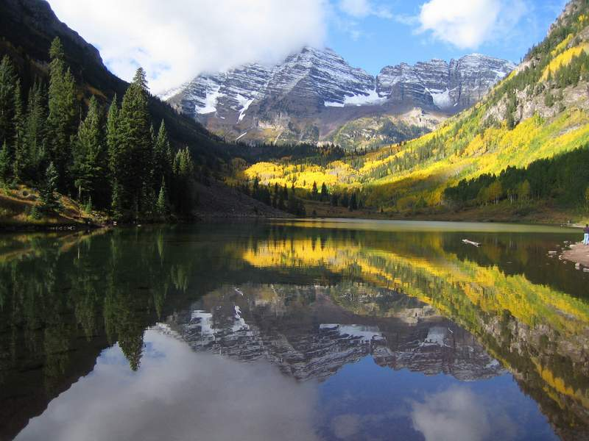
Aspen, CO

Slide 49

Data in Formative decisions
Policies and Legislation

Slide 50
Data in Formative Decisions
To inform and change policy
To aid in P-20 understanding
State and Federal Mandates

Slide 51
Data Sharing
Colorado Department of Education
School Districts
GEARUP, TRIO, other Pre-collegiate Programs
Institutions, Researchers, Graduate Students
Share aggregate data daily/publicly
  i3: Searches, Downloads, Reports
Sharing potential and practice increasing☺

Slide 52
Data in Legislative Decisions
Concurrent Enrollment – ASCENT
Reverse Transfer – Credit When It’s Due
SASID Linkage (K-12 to Postsecondary link)
Performance Funding

Slide 53
Data in Policy Decisions
Remedial Assessment
  2013-14 Revisions by statue
  K-12 accountability measure
Admission Index/Cut Score
  2013-14 Revisions by statue
  K-12 and HE Alignment

Slide 54
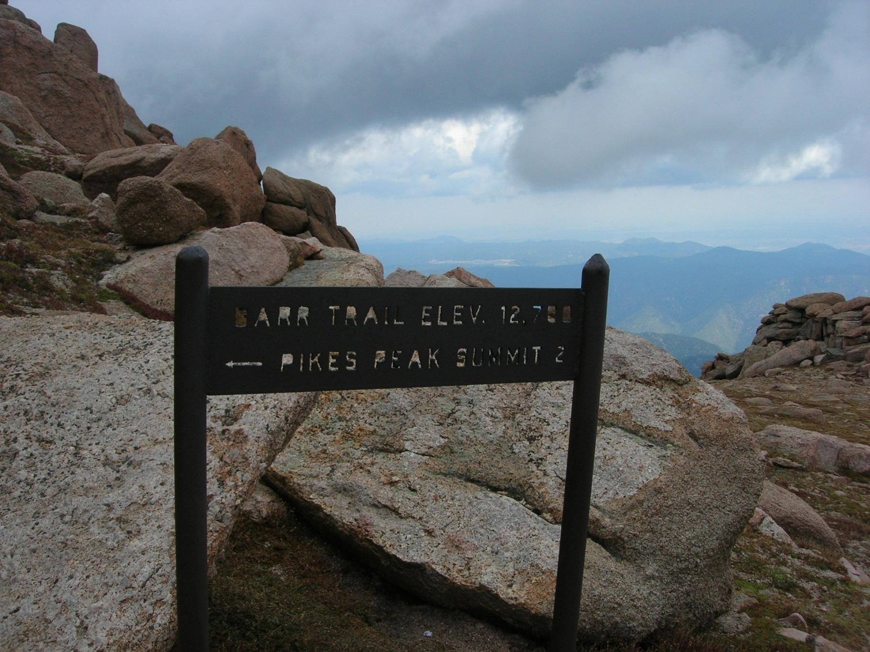
Hiking Pikes Peak: Summit is 14,114 feet above sea level

Slide 55
Data in GEARUP decisions
Administration, Management, Services

Slide 56


Slide 57
Data in GEAR UP Administration
Service Data
  Informs Student Contact Hours
Missing Service Data
  Advisor Management
Remediation Progress, Achievement
  Informs Need for Interventions
College GPA, Attendance
  Inform need for College Services

Slide 58
Data Analyzing GEAR UP Decisions
GU2 (Cycle 2005-2011)
Dual Courses & CLEP Tests
  Transcripted Hours
  On-Track to Graduate
Cohorts, Year-by-Year Tracking
  College Matriculation Rates
  College Persistence
  Success Rates

Slide 59
GEAR UP Results
GU2 (2005-2011)
First Graduating Cohort in May 2011
87 % - On-Time Graduation (of Active 9th-12th)
  72 % Statewide Rate
84 % - College Going Rate (of HS Graduates)
  46% Statewide Rate (to Public Colleges)
81 % - Year 1 College Persistence
69 % - On Track To Graduate
  44 % Statewide Rate
Source: Colorado GEAR UP - Improving Academic Achievement: A Report on Colorado GEAR UP II At-Risk Student Outcomes, August 2012

Slide 60
Data Influences GEAR UP Decisions
GU3 (2011-2017)
State Remedial Rates, GU2 Students
  Need for Remedial Intervention
  GU3 Early Assessment and Enrollment
Remedial Progress Tracking
  Informs effective methods
  Identifies advisors/students needing extra attention

Slide 61
Ongoing Research
Further 2011 Graduates Analysis
  Combining efforts
    Colorado GEAR UP
    Colorado Department of Higher Education
    Colorado Department of Education
    National Research Institutions
      Harvard University
      Stanford University
      University of Colorado
      University of Michigan
      Vanderbilt University

Slide 62
Ongoing Research
Further 2011 Graduates Analysis
  In depth analysis of statewide dataset of high school students going to college, progress and outcomes
  Ranging concentrations of study
    Dual/Concurrent Enrollment
    Remedial Trends, Progress and Outcomes
    Effects of CLEP Testing
    Financial Aid
    Cost-Benefit Analysis

Slide 63

Salida, CO

Slide 64
Best Practices, overview
What we got right

Slide 65
What We Have Learned
Data Drives Legislation, Policies, Decisions
  Remedial Report
    Early Remediation
    Delivery Methods
  Progress & Outcomes
    Transcript Framework
  Financial Aid Allocations to colleges
    Funding Models

Slide 66
What We Have Learned
Relationships
  Department of Education
  Local Education Agencies (LEA)
    Denver Public Schools Remedial Project
Make Data Available
  Available data leads to more discussion, progress, and change
  Corrections to data and data collection
  Transparency

Slide 67
What We Have Learned
Data Sharing
  No one knows what they want in the beginning
  Open communication leads to clear message
  Ask questions about data and what is being delivered, assumptions lead to errors
Think Long Term
  Baby steps are great, Redoing work is not

Slide 68
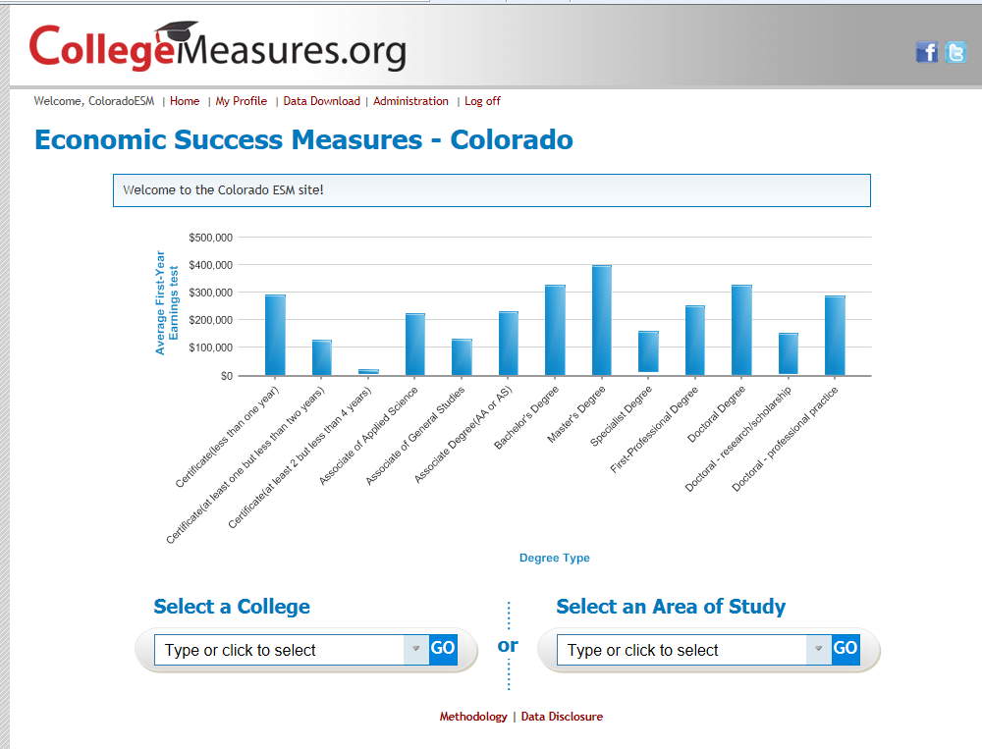

Slide 69
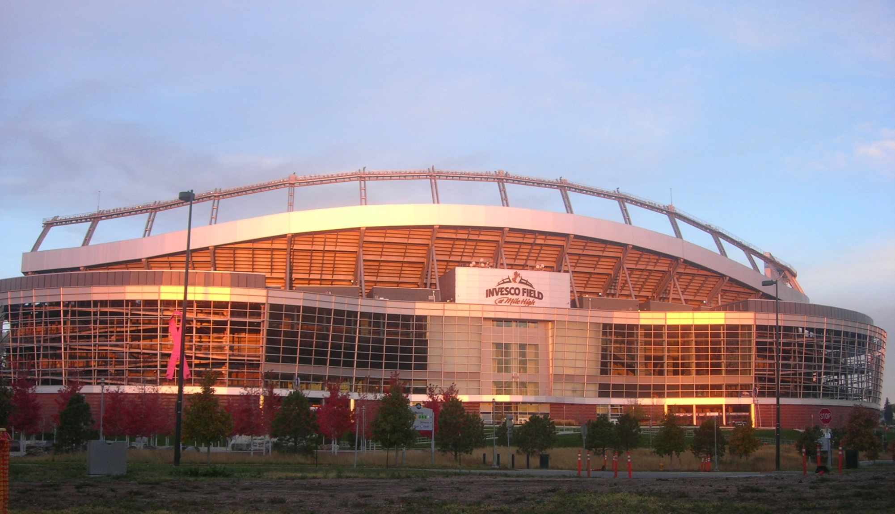
Denver Broncos

Slide 70
Best Practices,
COLORADO GEAR Up
Building on Success

Slide 71
What Have We Learned (GU)
Customize Data System
  Flexible, customized data system offers ability to track exactly what you need
    College Portfolio example
    Requires technical staff

Slide 72
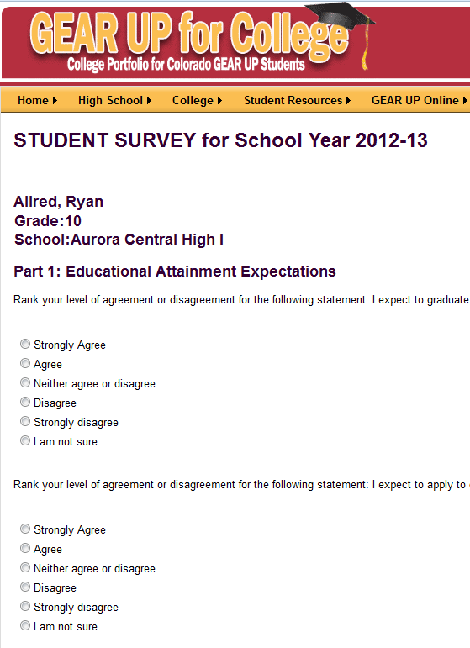
Online Survey
(Student &
Control)

Slide 73
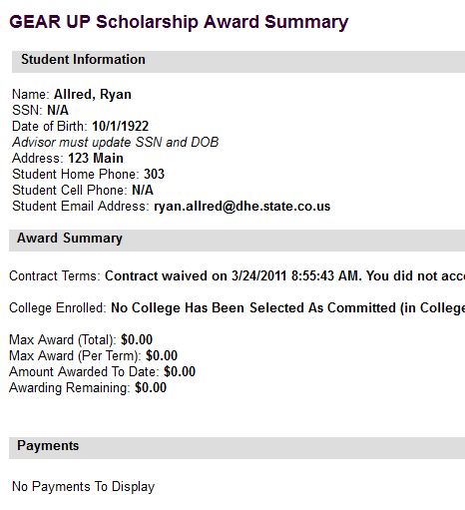
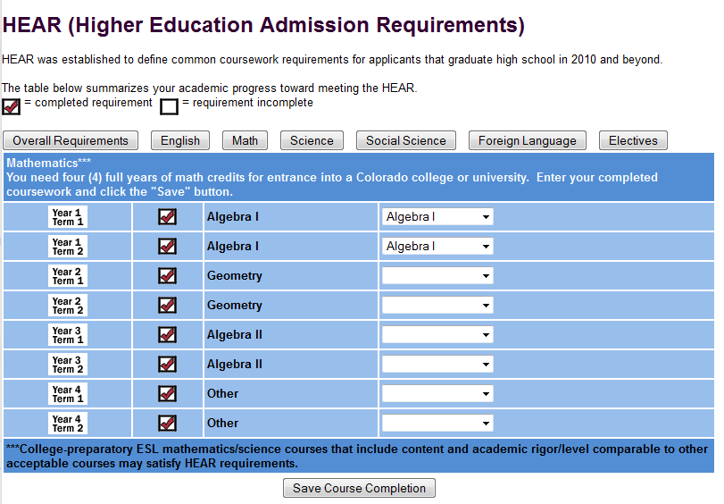
Custom
Curriculum

Slide 74
What Have We Learned (GU)
Be a Data Collection Overachiever
  More detail on student and services gives you the ability to review actions and make corrections
    Service Categories example
  Review data constantly, navigate accordingly

Slide 75
Service Category Example
Federal APR Categories (12)
Colorado GEAR UP Expansion (31)
College visit/College student shadowing
Computer Assisted Lab
Counseling/advising/academic planning/career counseling
Cultural events
Educational field trips
Family events
Job site visit/job shadowing
Mentoring
Other
Summer programs
Tutoring/Homework assistance/Academic enrichment
Workshops
ACADEMIC - Academic Intervention
ACADEMIC - Academic Planning
ACADEMIC - Credit Recovery
ACADEMIC - Remediation Lang Arts
ACADEMIC - Remediation Math
ACADEMIC - Tutoring/Homework
CAREER - Career Workshop
CAREER - Field Trip
CAREER - Internship
CAREER - Job Shadowing
COLLEGE - COF
COLLEGE - College Applications
COLLEGE - College Course
COLLEGE - College Essay
COLLEGE - College Readiness
COLLEGE - College Visits
COLLEGE - Financial Aid
COLLEGE - Research
COLLEGE - Scholarships
COLLEGE - Testing and Assessments
EXTRACURRICULAR - Community Service
EXTRACURRICULAR - Cultural Events
EXTRACURRICULAR - Summer Programs
MENTORING
PARENT - College Prep
PARENT - Family Event
PARENT - Field Trip
PARENT - Home Visits
PARENT - Telephone/Mail/E-mail
SURVEY - Parent
SURVEY - Student

Slide 76
What Have We Learned (GU)
Relationships
  Vital to efficient data collection, don’t key enter data that exists with a partner
    Link or Share
  Challenging the status quo can lead to hard conflict, then roadblocks
    Find benefit to partner, students and overall
    Communicate message

Slide 77
“Principal” Lessons Learned
Upcoming book, to be published in 2013
  “Get Your Ass to College: How One School Closed the Achievement Gap”
  By Dr. Scott Mendelsberg, Executive Director of Colorado GEAR UP, former principal of Abraham Lincoln High School
  This book describes the galvanizing program Lincoln called College Now that changed the school and forced the State of Colorado to change the way it viewed education. How this program increased the college matriculation rate from 17% to 73% in one year. The Colorado State Governor, the Denver Mayor, state senators and congressmen, future U.S. Senators and Congressmen and U.S. Presidential cabinet members are all involved in one way or the other, plus the President of the United States.

Slide 78
Visit Us – DHE & CGU
Please visit our website. Data and reporting is only valuable if it is used.
http://highered.colorado.gov
http://highered.colorado.gov/i3/
http://www.coloradogearup.org
Questions and comments?
Thank you!

